Slide 1
Dimension(ality) Reduction R Series
Part I - Feature Selection; SP24
Instructor: Aishat Sadiq
Helper: Jacob Grippen

Slide 2

Houston, we have a problem: Big Data!
Notes:
High-dimensional data have become more common in many scientific fields as new automated data collection techniques have been developed.
It's estimated that 1.7 megabytes of data are created every second for every person on earth---the same amount of data needed to store an 850 page book, per second.
Our ability to generate, gather, and store volumes of data has far outpaced our ability to derive useful information from it in many fields, with available computational resources.
Such datasets pose a challenge for data analysis as standard methods of analysis, such as linear regression, are no longer appropriate. Therefore, data reduction is a critical step in order to turn large datasets into useful information, the overarching purpose of data science.
(https://time.com/6108001/data-protection-richard-stengel/)

Slide 3
Github
Download all the Github files
Unzip package
Open project and script files using R project file
Readme section of the Github page

Slide 4
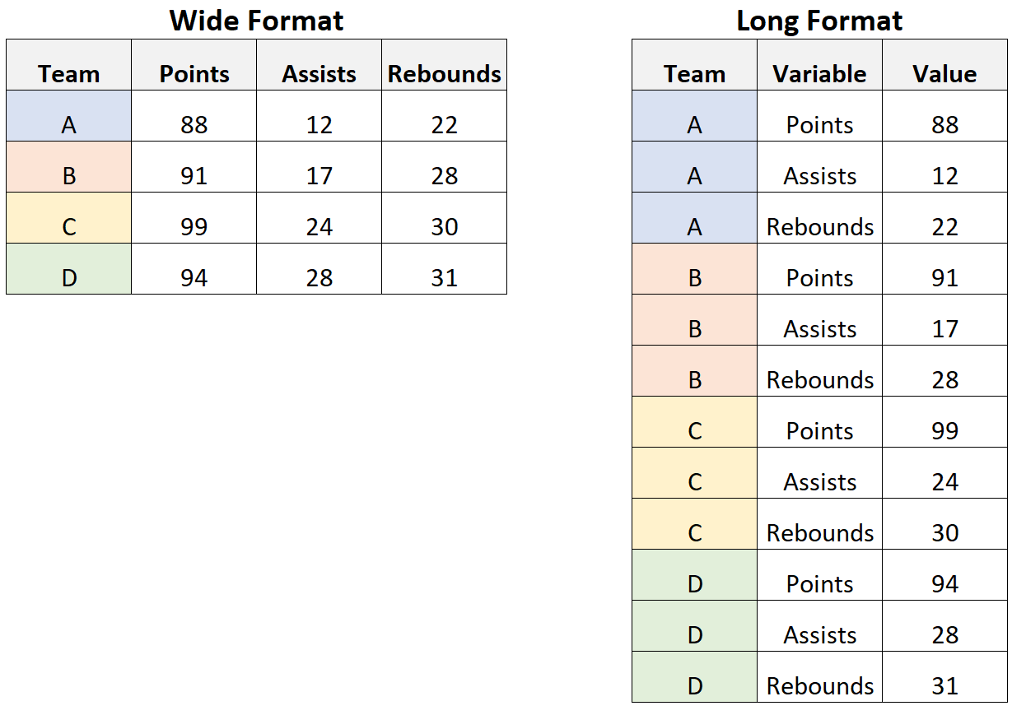
What are high-dimensional data?
Data in which the number of features (variables observed), p, are close to or larger than the number of observations (or data points), n.
Popular uses of high dimensional data:
Genomic data
Neuroimaging data
High-dimensional time series
Ecology (especially biodiversity studies)
Exploratory Data Analysis
Structural Equation Modeling
Topic modeling
Signal detection
Notes:
Similar to wide data learned in the Data Preprocessing Workshop.
I recently had to change very wide data to long data in order to run certain dissimilarity/segregation analyses using R and QGIS.
These all use models or algorithms to solve problems (like regression). But, high dimensional data can lead to long training times and model overfitting or even prediction and classification errors.
https://carpentries-incubator.github.io/high-dimensional-stats-r/aio/index.html

Slide 5
The Curse of Dimensionality
[Bellman et al., 1957]
Notes:
Imagine you're trying to navigate through a huge maze with many twists and turns. The more dimensions (or features) you add to the maze, the harder it becomes to find your way through it. In high-dimensional datasets, each additional feature adds a new dimension to the "maze" of data. This makes it increasingly difficult for algorithms to effectively analyze and interpret the data because there are so many possible combinations and relationships between the features. As a result, the curse of dimensionality causes problems like increased computational complexity, sparse data, and decreased predictive accuracy. In essence, it's like trying to find your way through a labyrinth with too many confusing paths, making it tough to make sense of the data.

Slide 6
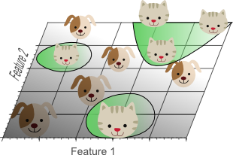
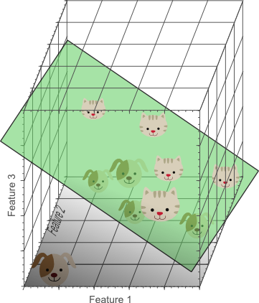
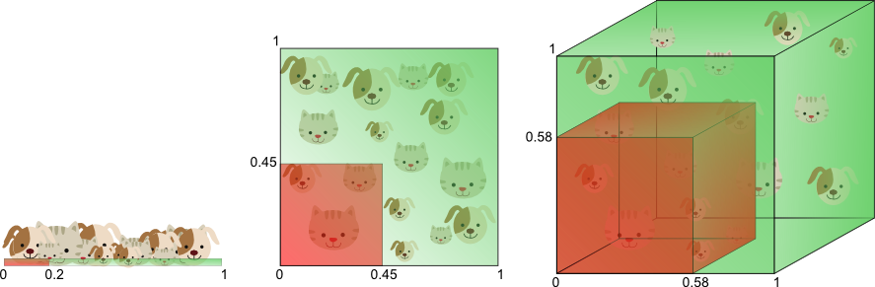
The curse of dimensionality introduces sparseness of the training data
The more features we use, the more sparse the data becomes such that accurate estimation of the algorithm's parameters becomes more difficult.
Another effect of the curse of dimensionality, is that this sparseness is not uniformly distributed over the search space.
Notes:
In simple terms, if we had an endless amount of data to train our system, we wouldn't have to worry about having too many features (or characteristics) to consider. But since we usually have limited data, we need to be careful about how many features we use. If we're using complex methods like neural networks or decision trees, we need to keep the number of features low to avoid overfitting, where the model memorizes the training data instead of learning from it. However, if we're using simpler methods like naive Bayesian or linear classifiers, we can use more features because these methods are less likely to overfit.
Cross-validation helps with overfitting, but we are not going to cover that topic today.

Slide 7
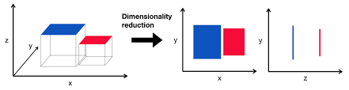
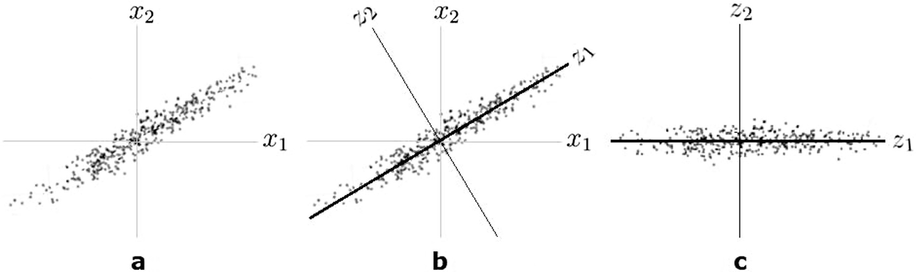
Dimensionality reduction incurs data loss
Goal: represent the same data with fewer variables by preserving the structure of the data*
In PCA the structure is defined by variance
How much of the variance of Y can be
explained by X?
Notes:
DM isn’t perfect, there are always tradeoffs in statistics
The goal of DM is to represent the same data with fewer variables, thus relieving us of the curse of dimensionality

Slide 8
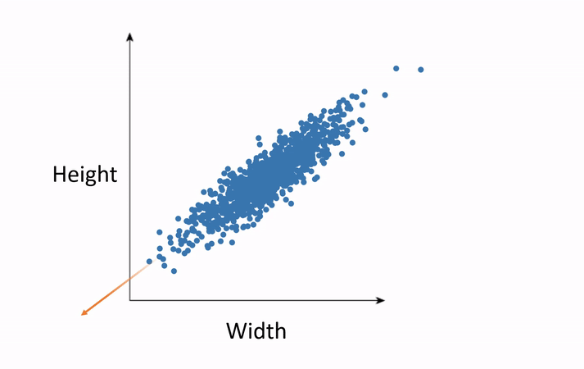
The ”true” dimensionality of the data is typically lower while the rest of the data can be seen as noise.
Notes:
https://webcache.googleusercontent.com/search?q=cache:https://medium.com/analytics-vidhya/multi-dimensional-data-boon-or-bane-3de73c9650bb&strip=0&vwsrc=1&referer=medium-parser

Slide 9
Benefits of Dimensionality Reduction
Compact storage for big, high dimensional data
Reduce model training/computation time
Improve Reduce multi-collinearity between features & lessens redundant data (noise)
Prevents overfitting
When used correctly, improves model accuracy, interpretability of findings, and data visualization

Slide 10

So, what are features?
These are individual measurable properties or characteristics of the data that we use to make predictions or draw conclusions.
Example: Predicting House Prices
Square footage
Number of rooms
Build date/Age
Location
Dependent Variable: Price
Notes:
In simpler terms, features are just different pieces of information about the thing you're studying. They help us understand and make decisions based on the data.
For example, if you're analyzing housing prices, features could include things like the number of bedrooms, the square footage of the house, the neighborhood it's in, the year it was built, etc.

Slide 11



Building Intuition: Animal Classification
Features: ears, fur, nose
Notes:
* Images and speech are usually high dimensional data because we choose to represent text with individual words and images with individual pixels.
Consider an example in which we have a set of images, each of which depicts either a rabbit or a dog. We would like to create a classifier that is able to distinguish dogs from rabbits automatically. To do so, we first need to think about a descriptor for each object class that can be expressed by numbers, such that a mathematical algorithm, i.e. a classifier, can use these numbers to recognize the object. We could for instance argue that rabbits and dogs generally differ in color. A possible descriptor that discriminates these two classes could then consist of three number; the average red color, the average green color and the average blue color of the image under consideration. A simple linear classifier for instance, could combine these features linearly to decide on the class label:
However, each of these three color-describing numbers, called features, will obviously not suffice to obtain a perfect classification. Therefore, we could decide to add some features that describe the ears and nose of the animal. We now have 5 features that, in combination, could possibly be used by a classification algorithm to distinguish rabbits from dogs.
To obtain an even more accurate classification, we could add more features, based on color or texture histograms, statistical moments, etc. Maybe we can obtain a perfect classification by carefully defining a few hundred of these features? The answer to this question might sound a bit counter-intuitive: no we can not!. In fact, after a certain point, increasing the dimensionality of the problem by adding new features would actually degrade the performance of our classifier.

Slide 12
Research Study
"We study race in the labor market by sending fictitious resumes to help-wanted ads in Boston and Chicago newspapers. To manipulate perceived race, resumes are randomly assigned African-American- or White-sounding names. White names receive 50 percent more callbacks for interviews. Callbacks are also more responsive to resume quality for White names than for African-American ones. The racial gap is uniform across occupation, industry, and employer size. We also find little evidence that employers are inferring social class from the names. Differential treatment by race still appears to be prominent in the U. S. labor market.” (Bertrand & Mullainathan, 2004)
Notes:
- Measured whether a given resume elicits a call back or e-mail back for an interview. For each phone or email response, we use the content of the message left by the employer (name of the applicant, company name, telephone number for contact) to match the response to the corresponding resume-ad pair.
Not a workshop to analyze the merits of the study, but to use the data to understand big data methodology!! Its one of the largest clean datasets I could find.
- Limitations: crude approximation for outcome measure (call back), and use of names to indicate race
https://vincentarelbundock.github.io/Rdatasets/doc/openintro/labor_market_discrimination.html
https://www.openicpsr.org/openicpsr/project/116023/version/V1/view
https://www.nber.org/system/files/working_papers/w9873/w9873.pdf

Slide 13
Definition
Feature Selection is the process that removes irrelevant and redundant features from the data set. The model, in turn, will be of reduced complexity, thus, easier to interpret.

Slide 14
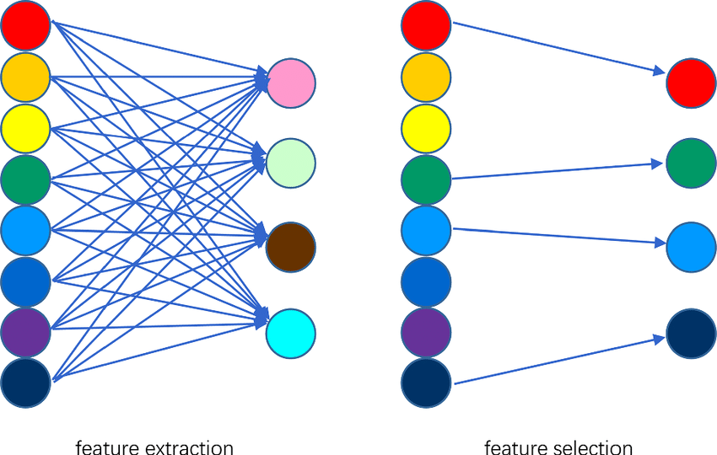
Feature Extraction vs. Feature Selection
Uses domain knowledge and/or statistical tests to select the most relevant variables.
Constructs a new set of dimensions
Notes:
Feature selection is about choosing the most important features from your dataset to use in your analysis. You're selecting specific features that are most relevant to your problem.
Feature extraction is about creating new, more meaningful features from the existing ones. You're transforming or combining the original features to capture the most important information in a more compact way.

Slide 15
Common Feature Selection Techniques
Filter Methods (uni/multi-variate tests)
Wrapper Methods
Backward Stepwise Selection
Forward Stepwise Selection
Exhaustive Search Selection
Sequential Replacement Selection
Embedded Methods
LASSO
Tree-based methods
Notes:
Filter Methods:
Think of a filter like a sieve that sifts through grains of sand. In filter methods, we look at each feature independently and score them based on some criteria, like how much they correlate with the target outcome. Then, we keep the features that pass the filter's threshold and discard the rest. It's like picking out the best grains of sand based on certain characteristics.
Wrapper Methods:
Wrapper methods are like trying on different combinations of clothes to see which outfit looks best. Here, we use a specific machine learning algorithm to evaluate different subsets of features. We try out different combinations, train the model with each combination, and then pick the one that performs best according to some performance metric, like accuracy or error rate.
Embedded Methods:
Embedded methods are like having a fancy car with built-in navigation. These methods incorporate feature selection directly into the model training process. The model itself decides which features are most important for making predictions. It's like GPS having the car figure out the best route to take without you having to manually input directions.

Slide 16
Filter Methods
Correlation-based feature selection using cor() function
Features are filtered based metrics like Pearson’s correlation with the dependent variable
Feature scaling is a method of adjusting observation values to a common scale and is used to normalize/standardize the data prior to using ML algorithms and regularization (eg. LASSO & Ridge)
Eg. Min-Max Normalization, Mean Normalization, Z-score Normalization
Pro: Faster computing time/efficiency Con: may not select the best features
Notes:
Filter Methods: Independently assess features and keep the best ones based on some criteria.
Pros:
Computationally efficient: They analyze features independently of the learning algorithm, making them faster.
Typically less prone to overfitting because they don't involve the learning algorithm.
Can be useful for data exploration and understanding relationships between features.
Cons:
May not consider interactions between features, potentially missing important relationships.
Might overlook redundant or irrelevant features since they assess features independently.

Slide 17
Wrapper Methods
Feature selection algorithm “wraps” around the predictive model algorithm and uses the same model to select the best features
Pro: Selects the best features/best model performance
Con: Computationally expensive, prone to overfitting
Forward and backward selection with stepwise regression
Recursive Feature Elimination (RFE) using rfe() from the caret package
Notes:
Wrapper Methods: Use a specific model to evaluate different subsets of features and select the one that performs best.
Pros:
Incorporate interactions between features, providing a more accurate selection.
Tend to yield higher predictive performance because they assess feature subsets based on the performance of a specific learning algorithm.
Cons:
Computationally expensive since they evaluate different feature subsets using the learning algorithm iteratively.
Prone to overfitting, especially with small datasets, as they can tailor feature selection too closely to the specific training set.

Slide 18
Evaluating Feature Selection Performance
R ² ⁻ tend to choose models with more predictors, can never become smaller with added predictors, larger is better
RMSE - root mean-squared error, tends to choose models with more predictors
Adjusted R ² ⁻ penalizes for additional predictors and can decrease with added predictors, larger is better
Other penalization methods: LASSO and Ridge Regression
Akaike Information Criterion (AIC) - 2p is called a penalty component, smaller is better.
Bayesian Information Criterion (BIC) - larger penalty than AIC, generally picks a smaller model than AIC, smaller is better.
Notes:
penalty for BIC is log(n)p rather than the AIC’s penalty of 2p

Slide 19

Workshop Evaluation QR Code
Notes:
https://forms.office.com/Pages/ResponsePage.aspx?id=ZkN-XZsbz0WOebFLJ99G4SUXqdLlghJDhzZ5bd0gLPtUQVlLU0pBRlVLN1dGUkVTQUE2VFE0UThKQi4u&origin=QRCode

Slide 20
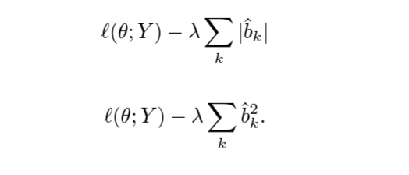
Embedded Methods
Use concepts from both wrap and filter methods.
Pro: fast, accurate, and less prone to overfitting
Con:
LASSO (Least Absolute Shrinkage and Selection Operator) with the glmnet package
Tree-based methods for feature importance using randomForest or xgboost
Notes:
Embedded Methods: Incorporate feature selection directly into the model training process, letting the model itself decide which features are most important.
LASSO & Ridge Regression – two ways to fit (GLMs) regressions when the number of covariates is large relative to the number of samples using a penalty that fixes the tuning parameter lambda and minimizes coefficient least squares estimates. Instead of trying to minimize the RSS + penalty, we instead try to maximize the log-likelihood-penalty.
Pros:
Feature selection is integrated into the model training process, ensuring that selected features contribute directly to model performance.
Generally more computationally efficient than wrapper methods since feature selection is part of the model training.
Cons:
Limited to the feature selection capabilities of the specific learning algorithm being used.
May not generalize well to other learning algorithms or datasets if the embedded feature selection is too tightly coupled with the model.

Slide 21
Be careful of P-hacking!!
Notes:
These methods can lead to inflated performance metrics and false discoveries in social science research especially because of the focus on correlation!!
Machine learning often involves testing many hypotheses simultaneously, especially when exploring different models, feature sets, or hyperparameter combinations. Without appropriate corrections for multiple comparisons, researchers may report statistically significant results that are actually false positives.

Slide 22
Resources/Further Reading
https://www.john-ros.com/Rcourse/multivariate.html
https://doi.org/10.4324/9781003279693
Evaluation of economics journals based on structural equation dimension reduction method: https://doi.org/10.1080/15140326.2021.1984163
https://link-springer-com.proxy.library.cornell.edu/book/10.1007/978-3-031-05371-9

Slide 23
Resources/Further Reading
Nguyen, Lan Huong, and Susan Holmes. “Ten quick tips for effective dimensionality reduction.” PLOS Computational Biology 15.6 (2019): e1006907.
Li, Lexin. “Dimension reduction for high-dimensional data.” Statistical methods in molecular biology. Humana Press, Totowa, NJ, 2010. 417-434.

Slide 24
Resources/Further Reading
An Introduction to Statistical Learning (ISLR) by James, Witten, Hastie and Tibshirani: http://www-bcf.usc.edu/~gareth/ISL/
Notes:
R code for feature extraction and model performance
https://www.john-ros.com/Rcourse/unsupervised.html#dim-reduce
https://rpubs.com/marwahsi/tnse

Slide 25
What questions do you have?

Slide 26
Workshop Evaluation QR Code
Notes:
https://forms.office.com/Pages/ResponsePage.aspx?id=ZkN-XZsbz0WOebFLJ99G4SUXqdLlghJDhzZ5bd0gLPtUQVlLU0pBRlVLN1dGUkVTQUE2VFE0UThKQi4u&origin=QRCode

